Slide 1
DataStage to Matallion Migration – High Level Testing Strategy

Slide 2
High Level Test Strategy (Illustration)
Managed Environments – Future State + Current State
Project Team Development and Initial Test Environments
SIT
DataStage File Storage & ETL
Scope:
Regression A/B Testing against Netezza
A/B Results Summary
A/B Detail Diff Report
Manual runs to populate Netezza (not scheduled through HWA)
EDRDEV
Matallion
Scope:
Develop A/B Testing Requirements and Logic
Develop A/B Results Summary & Diff Report
Configure A/B Testing against both the SRDM replicated layer and the Netezza Dev environment
Snowflake
AB
Netezza
SRDM
ADLS
Oracle
Snowflake
CI/CD
DEV
AB
DEV-IIT
UAT
DataStage File Storage & ETL
Scope:
Regression A/B Testing against Netezza
A/B Results Summary
A/B Detail Diff Report
Validate HWA Scheduling
It is valid for A/B Testing to occur in SIT and/or UAT on an application-by-application basis, with dependencies on data availability and Collision Mitigation.
Matallion
Matallion
CI/CD
Matallion
Snowflake
Snowflake
Snowflake
AB
Netezza
ADLS
ADLS
ADLS
Oracle
*Logically rather than Physically separated environments
CI/CD
Current State Development Environment
Scope:
Capability to get copies from Managed Environments into Netezza DEV based on integration testing needs, typically uses Test Minor data
AB
AB
PROD
Scope:
Reasonableness checks as opposed to Regression A/B Testing
Defect process based on business feedback
DataStage File Storage & ETL
Matallion
Netezza
Snowflake
Oracle
ADLS

Slide 3
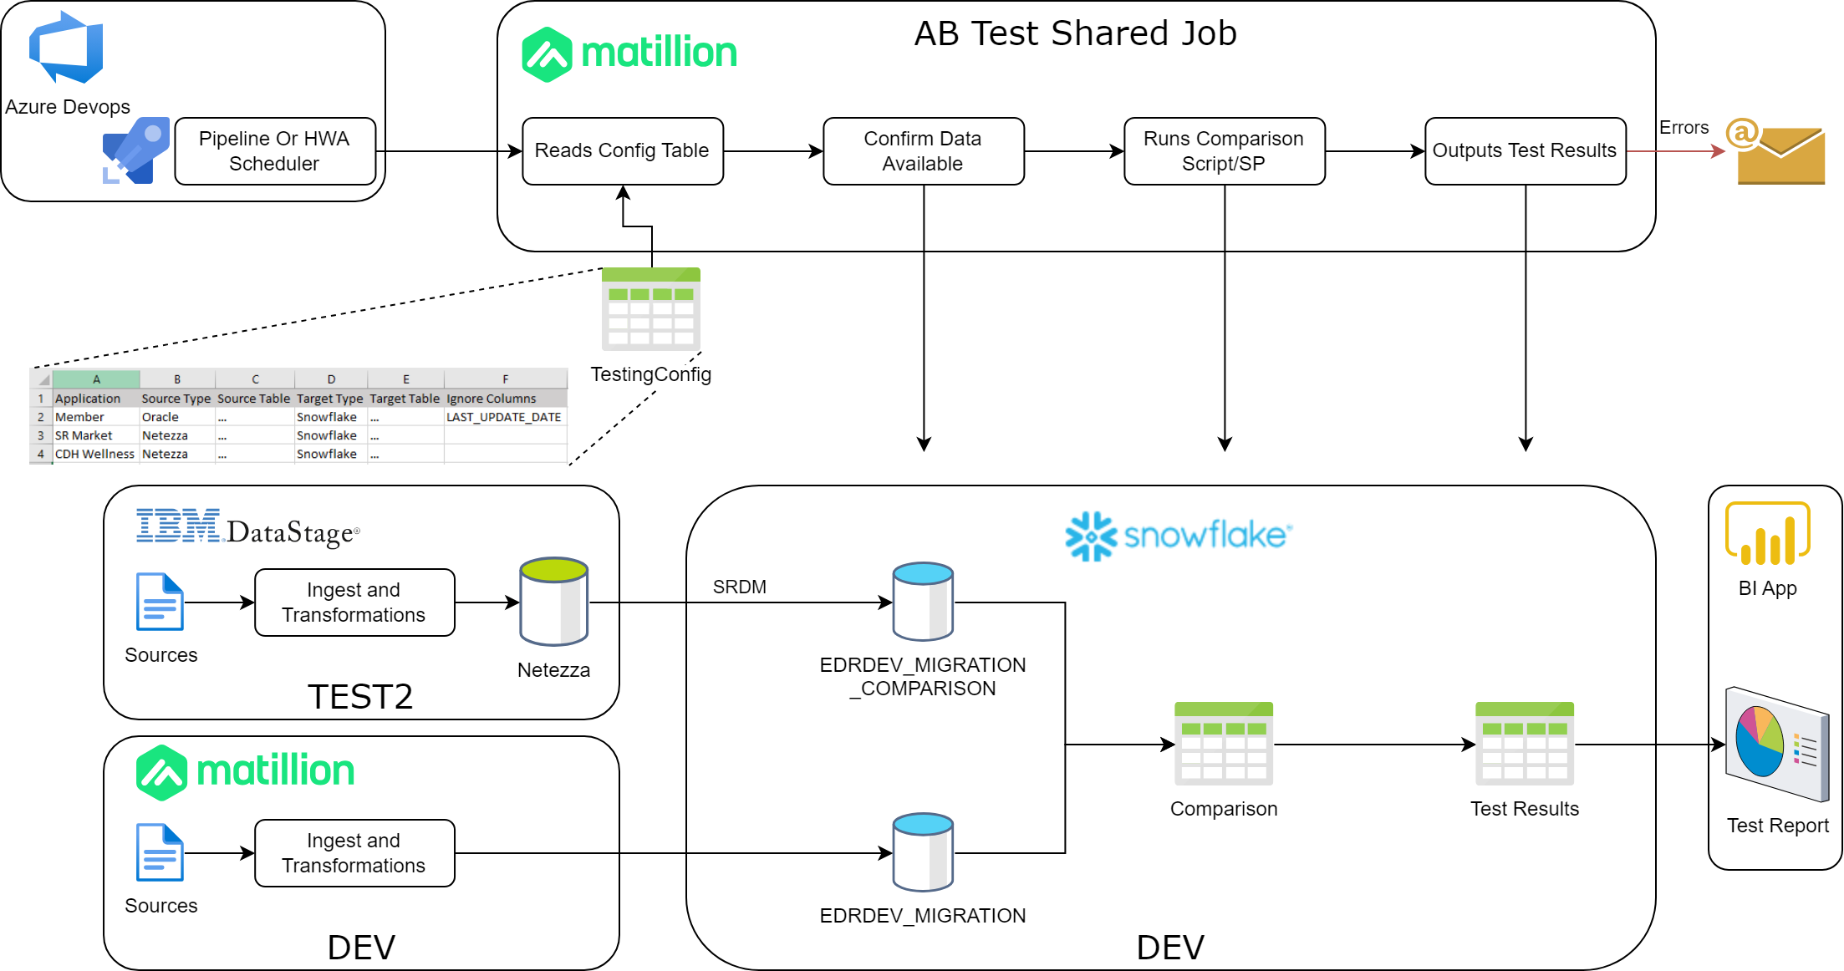
AB

Slide 4
Validation / Test Plan:
Key Decision(s):
A/B Testing stategy can either focus on the main table or file being created as part of an application conversion. Recommendation is to check each table that is written to.
For each application, use the requirements documenations (SRS, SDD, STTM) to identify source and target tables/files at an application level.
Depending on data volumes and comparison perfomance determine how to setup the configuration table for a given application.
Summary results will persist and keep continous records. Detailed Difference reports will only be available for the current test run.
Application | Impacted Tables | Read / Write
Sr Market Meals | FHD_ENAD_ADDRESS_D | Read
Sr Market Meals | FOOD_INSECURITY_ANSWER_REF | Write
Sr Market Meals | FOOD_INSECURITY_FACT | Write
Sr Market Meals | MEAL_ORDER_FACT | Write
Sr Market Meals | MEAL_ORDER_MENU_REF | Write
Sr Market Meals | MEAL_ORDER_STATUS_REF | Write
Sr Market Meals | TB_FOOD_DELIVERY_UTILIZATION | Write
Sr Market Meals | TB_FOOD_INSECURITY | Write
Sr Market Meals | TB_FOOD_ORDER_UTILIZATION | Write
Sr Market Meals | VW_MEMBER_ADDRESS | Read
Sr Market Meals | VW_MEMBER_ELIGIBILITY_FACT | Read
Sr Market Meals | VW_MEMBER_ELIGIBILITY_FACT_HISTORY | Read
Sr Market Meals | VW_PRODUCT_CLIENT_CONTRACT | Read

Slide 5
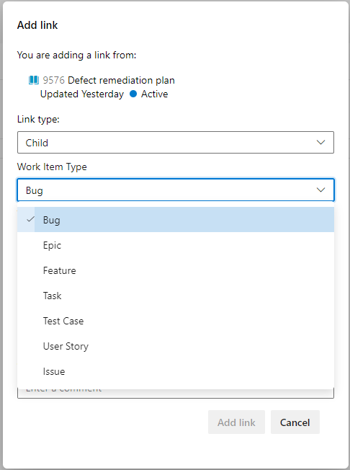
Defect Remediation Plan:
Work Item Type: Bug
Relevant Fields:
Steps to Reproduce
System Info / Found In Build
Acceptance Criteria
Integrated in Build
Priority
Severity
Issue bugs against User Stories, the User Stories should reflect a particular application that is being converted.
In this example the Bug report is mainly to track the results of A/B Testing and the need to fix something in the Matallion code for the converted application.

Slide 6
Discussion Notes:
Review Comments: 9/27/2023
A/B Data Validations:
Legacy keys, which are business/natural/composite keys should be generated the same regardless if they are part of initial or incremental data loads (current state or future state)
Sequential surrogate keys need to be compared differently

Slide 7
Current State (Working Version)
Prime
CareMark
ClearCycle
PAPA
ABACUS
ONPOINT
CCMS
Vertafore
Altegra
External Vendors
Millonzi
Amwell
EyeMed
ILS
HCFS
HMS
Mede
Wipro
Brown Univ
UCD
Landmark
VirginPlus
NationsHearing
Altegra
London Health
Prospect
Zest Health
HHS
* Its not complete list of vendors
BCBSRI
1
Sterling Secure File Transfer
Vendor Incoming Files
BCBSRI Gateway Server(ODS)
a
FTP
Infogix
c
7
Vendor Outgoing & Incoming Files
Enterprise Admin System
File Validations
Ref & Cert
Imputation
Balance & Control
4
Self Serv Portal
Facets
2
b
OCL
ACCUM
MSS
Extracts
Sr Market
EDR-Finance
EDR-CMS
PCP
DENTAL
EDR-Claims
EDR-Non-Claims
EDR-ACG
EDR-HCG
ITS-Host
MEDHOK
FEP
5
Publish
Landing
EVP
Stage
LTC
CPB
CDH
PBM
SAS
Claims
Non-Claims
Case Management
Network
Billing
Income
DataStage File Storage & ETL Processing Engine
6
BOXI
Netapp storage
Netezza
FDA
Oracle Landing
ABC
DOP
CPB
Other Demand
Internal applications
EVP
Staging
Claims
Non-Claims
Case Management
Network
Billing
Income..
Cert
Cert Hist
Database Storage & SQL processing Engine

Slide 8
DataStage Netezza Oracle Environment
Application | Component |  | Dev | SIT | Test/SIT Minor | SIT Test 2 | SIT Major | UAT | Production
FDA | Netezza | Server | NPSDEV | NPSDEV | NPSDEV | NPSDEV | NPSTEST | NPSTEST | NPSPROD
 |  | Database | FDADEV1 | FDATST2 | FDATST6 | FDATST4 | FDATST8 | FDAUAT1 | FDAPRD1
 | DataStage | Project Name | FDADEV | FDATST | FDATST1 | FDATST3 | FDATST2 | FDAUAT | FDAPRD
EDR | Oracle | Server | bazeu2dledr01 | bazeu2tledr02 | bazeu2tledr02 | bazeu2dledr01 | bazeu2tledr02 | bazeu2tledr02 | bazeu2pledr02
 |  | Database | CBIDEV3 | CBITST1 | FACTST1 | FACDEV1 | FACTST3 | CBIUAT1 | CBIPRD1
 | Netezza | Server | NPSDEV | NPSDEV | NPSDEV | NPSDEV | NPSTEST | NPSTEST | NPSPROD
 |  | Database | HIWDEV2 | HIWTST2 | FACTST2 | RPTTST2 | FACTST4 | HIWUAT1 | EDRPRD1
 | DataStage | Project Name | CBIDEV | CBITST | BTRTST1 | CBITST2 | BTRTST2 | CBIUAT | CBIPRD
FDM | DataStage | Project Name | FDMDEV | FDMTST | FDMTST1 | - | FDMTST2 | FDMUAT | FDMPRD
ABC | Netezza | Server | NPSDEV | NPSDEV | NPSTEST | NPSTEST | NPSTEST | NPSTEST | NPSPROD
 |  | Database | ABCDEV1 | ABCTST1 | ABCUAT1 | ABCUAT1 | ABCUAT1 | ABCUAT1 | ABCPRD1
MSS | Netezza Source | Database | HIWDEV3 | RPTTST2 | FACTST2 | - | FACTST4 | - | EDRPRD1
 | DataStage | Project Name | MSSDEV | MSSTST | MSSTST1 | MSSTST2 | MSSTS2 | - | MSSPRD
SQL server – QA database exist

Slide 9
DataHub Environment
Development
SIT(Minor)
UAT((Major/PPM0)
Production
ST(Test 2)
To be created
Azure Data Lake Storage Gen 2
<<Dev Storage Account>>
/<<Container>>/<<Directory>>
<<Dev Storage Account>>
/<<Container>>/<<Directory>>
<<SIT Storage Account>>
/<<Container>>/<<Directory>>
<<UAT Storage Account>>
/<<Container>>/<<Directory>>
<<PRD Storage Account>>
/<<Container>>/<<Directory>>
Matillion
<<Dev Matillion Instance>>
Projects
EDR Supply
Demand
<<Dev Matillion Instance>>
Projects
EDR Supply
Demand
<<Test Matillion Instance>>
Projects
EDR Supply
Demand
<<Test Matillion Instance>>
Projects
EDR Supply
Demand
<<Prod Matillion Instance>>
Projects
EDR Supply
Demand
<<Snowflake Org Account>>
Databases
LandingDev
FDADev
EDRDev
DOPDev
<<Demand-App-Database>>
<<Snowflake Org Account>>
Databases
Landing
FDA
EDR
DOP
<<Demand-App-Database>>
<<Snowflake Org Account>>
Databases
LandingMinor
FDAMinor
EDRDevMinor
DOPDevMinor
<<Demand-App-Database>>
<<Snowflake Org Account>>
Databases
LandingMajor
FDAMajor
EDRMajor
DOPMajor
<<Demand-App-Database>>
<<Snowflake Org Account>>
Databases
LandingProd
FDAProd
EDRProd
DOPProd
<<Demand-App-Database>>
Snowflake
Snowflake LLD
SDD_Cloud_Native_Data_Foundation_Layer_v1.0.docx
Matillion LLD

Slide 10
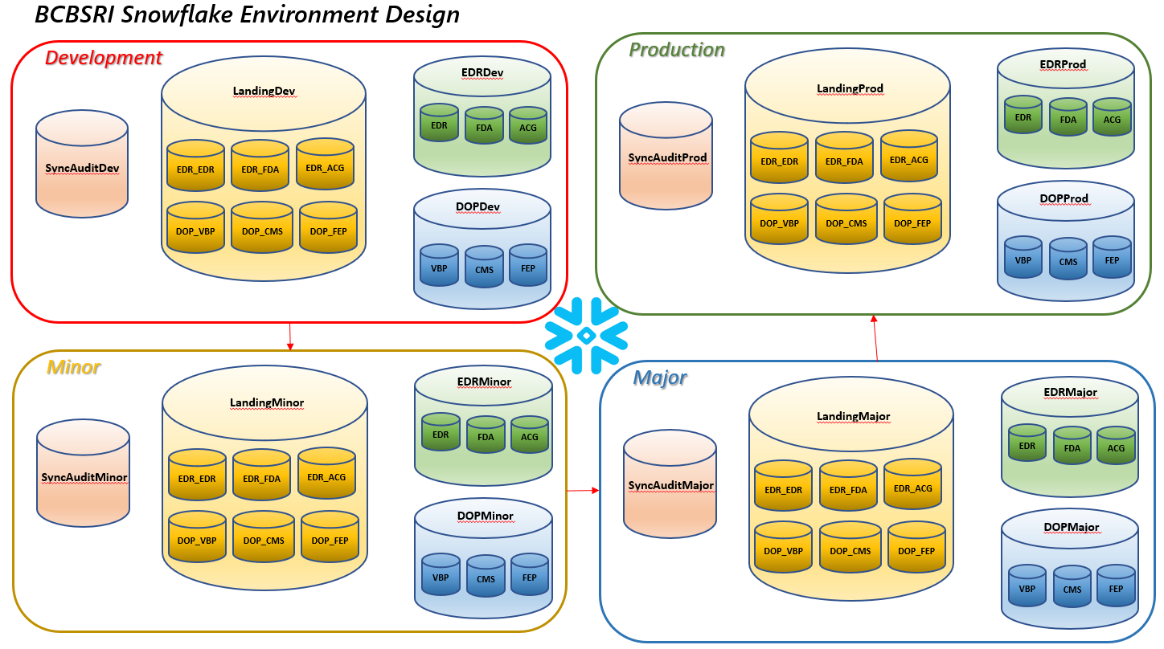
DataHub Snowflake Environment
Ref
SDD_Cloud_Native_Data_Foundation_Layer_v1.0.docx

